Slide 1
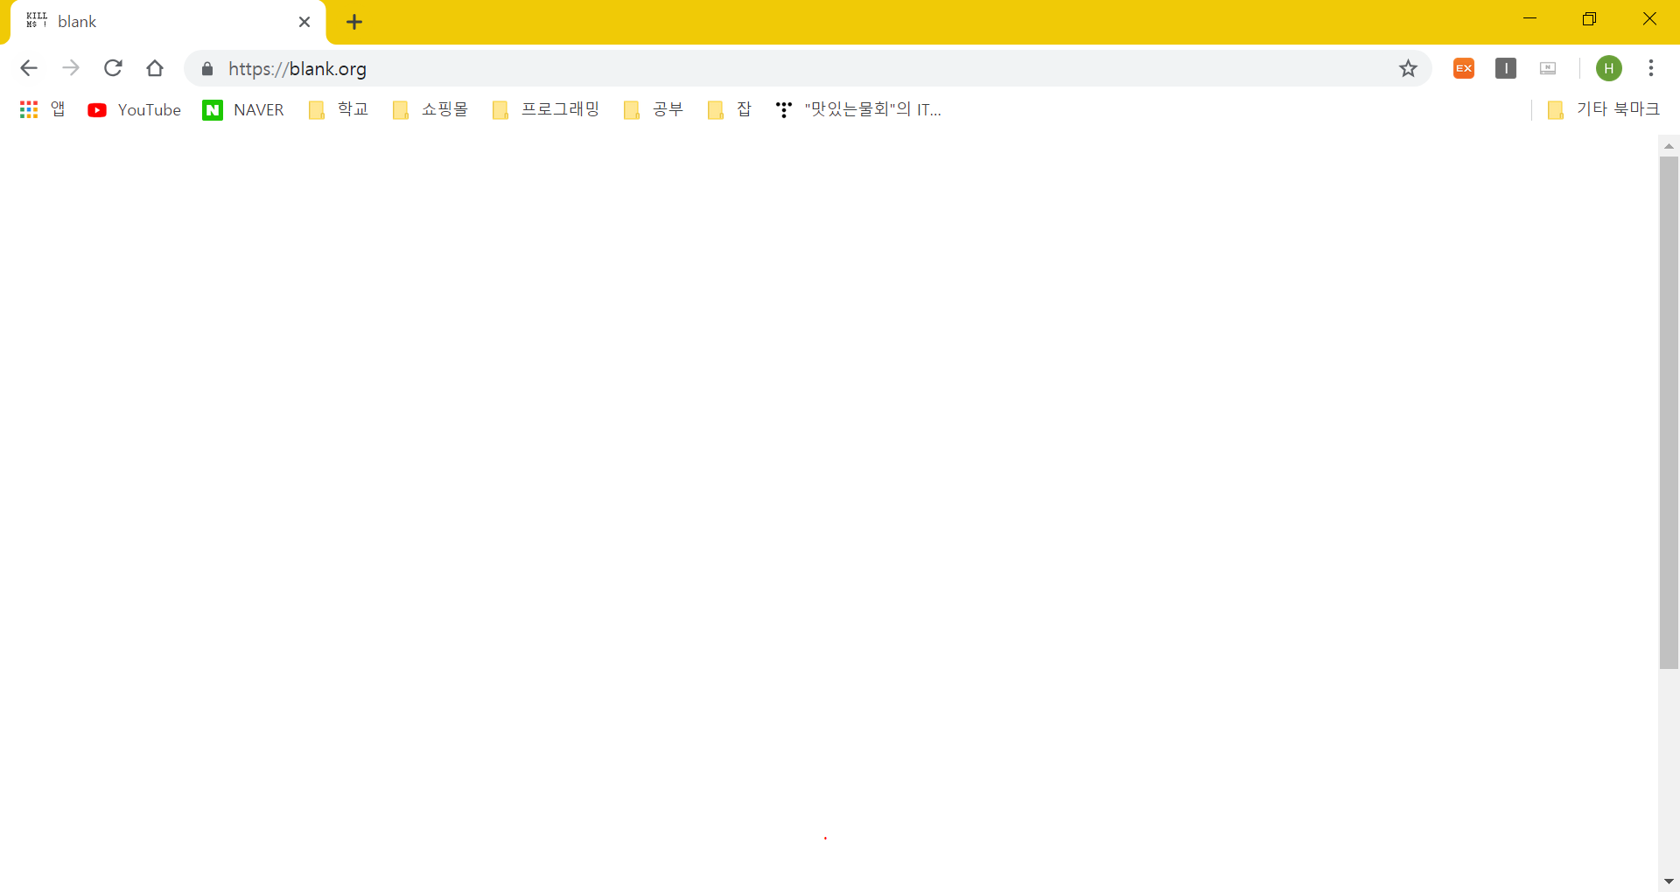
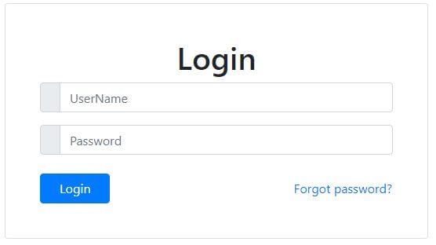

Slide 2
choose
Register
My page

Slide 3
Student
lessons
S
Java
C
Add time table
register
R
Log in
register
My page
E-learning
S
My
page
Time table
Java 9:00~
C 13:00~
Java
C
Edit
Edit
delete

Slide 4
lessons
subject | Professor name | Lesson Name | time | check
Java | Doho | Java basic | 9:00~ 11:00
C | James | C advanced | 13:00~ 15:00
c | Dorz | Korean expression | 15:00~ 17:00
korean | Minjeong | Alphabet | 11:00~ 13:00
register

Slide 5
Student
lessons
S
Java
C
Add time table
register
R
Log in
register
My page
E-learning
S
My
page
Time table
Java 9:00~
C 13:00~
Java
C
Edit
Edit
delete

Slide 6
Time Table
subject | Professor name | Lesson name | time
Java | Doho | Java basic | 9:00~ 11:00
C | James | C advanced | 13:00~ 15:00
c | Dorz | Korean expression | 15:00~ 17:00
korean | Minjeong | Alphabet | 11:00~ 13:00
Enter
Delete

Slide 7
Student
lessons
S
Java
C
Add time table
register
R
Log in
register
My page
My
page
Time table
Java 9:00~
C 13:00~
E-learning
Enter
Enter
Delete

Slide 8
doc
screen
close
Professor
cam
T
O
O
L
students
chat

